Slide 1
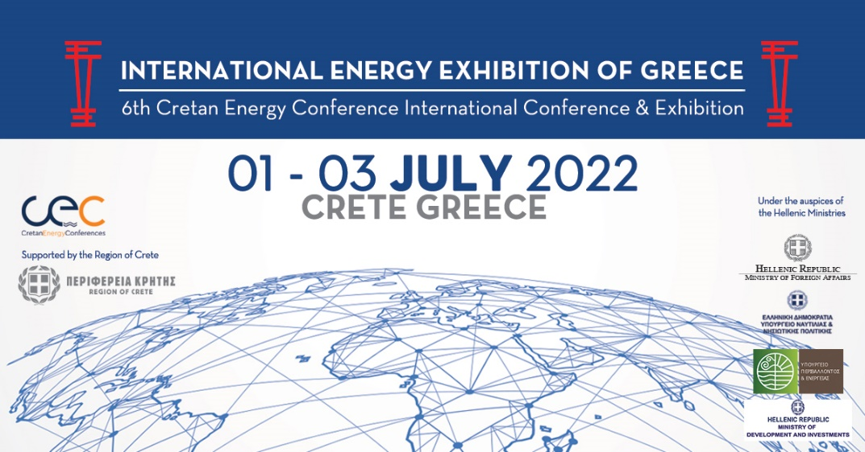
Geothermal energy in Greece
Prospects and challenges
Dr. Georgios Tsifoutidis
Geothermal energy Department
DG of Mineral Raw Materials
Hellenic Ministry of Environment and Energy

Slide 2
BASIC PREMICES
The present energy and critical raw materials crisis calls once again to the need for energy security, efficiency and wise use of natural and mineral resources.
The 2030 National Plan for Energy and the Climate sets specific goals on reducing CO₂ emissions, energy efficiency, saving of resources and sustainable development.
Geothermal energy is a renewable energy source (RES) that has the smallest CO₂ footprint among other RES, it offers power base load, it is cheap, it is safe and can provide important opportunities for local sustainable growth and diversification of local products.
The geothermal heat pumps are also an important tool for energy efficiency and energy cost savings.
IS THERE GEOTHERMAL ENERGY IN GREECE? YES. DO MANY PEOPLE KNOW? NO
WHERE ARE WE NOW?
International Energy Exhibition of Greece, 6th Cretan Energy Conference 2022

Slide 3
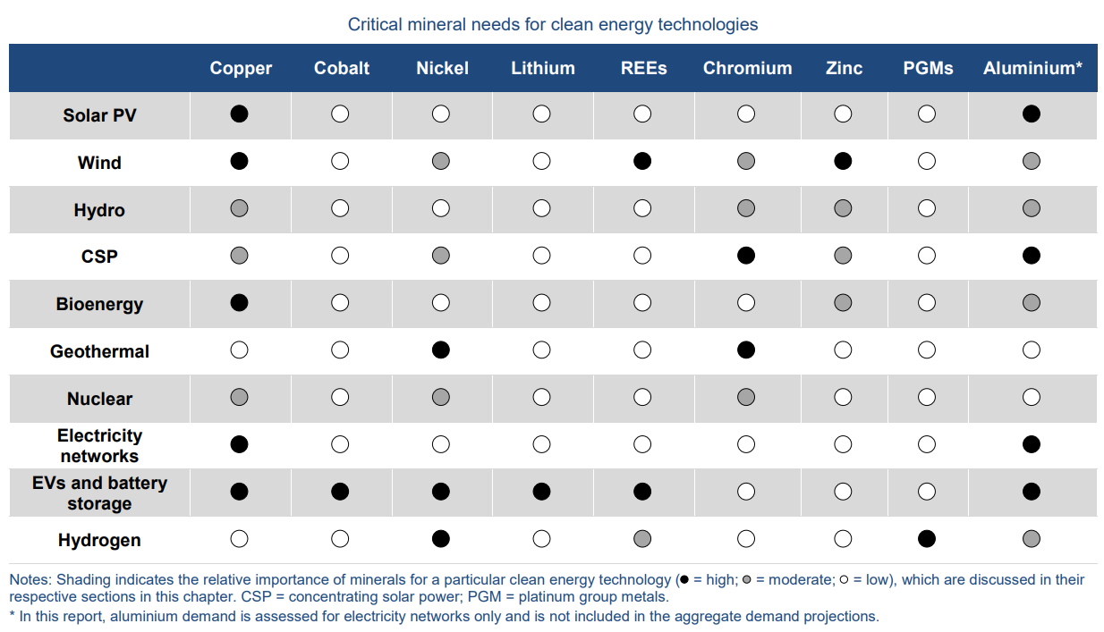
Geothermal energy is less demanding on critical raw materials and minerals and therefore greener and cheaper that other dominant RES in Greece. By contrast, storage facilities are very demanding in critical materials which increases dependency by non-EU countries.
Nickel and Chrome are available in Greece and neighbouring countries
IEA - The Role of Critical World Energy Outlook Special Report Minerals in Clean Energy Transitions, 2022 revision

Slide 4
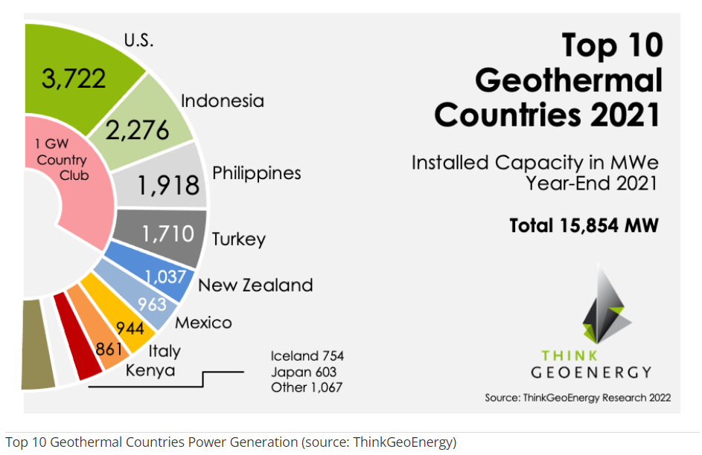
Geothermal energy doesn’t flow just anywhere but only where local geological conditions allow the transfer of earth’s heat closer to the surface.
Greece’s geothermal potential is manifested especially in central and east Macedonia, Thrace and certain islands along deep faults and past or present volcanic arcs.
Many countries have similar features and are taking full advantage of the base load capacity that geothermal energy offers.
Turkey shares many common geological features with the Greek islands in the E and NE Aegean Sea and soon may surpass 2 GWe installed capacity.
Where is Greece now?

Slide 5
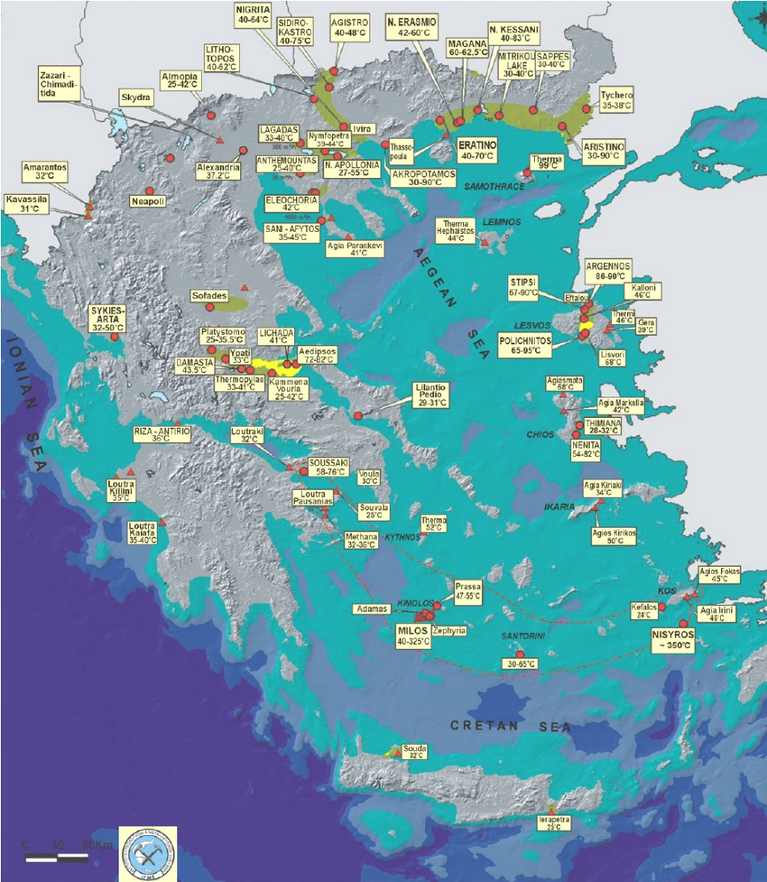
EAGME map of established geothermal fields and areas of geothermal interest in 2010.
No new H.T. discoveries. Emphasis on L.T. – M.T. exploration and exploitation mainly in Macedonia and Thrace.
PPC Renewables SA retains the exploration rights on 4 H.T. areas, (Milos & Kimolos islands, Nisyros island, Lesvos island and Methana peninsula). No power production yet.
There are promising areas for high temperatures’ applications, e.g. Nestos River delta, Evros River delta, Orestias basin, Strymon river basin, Akropotamos area, Chios island, Samothraki island, Sousaki area etc., that could be candidates for exploration and exploitation bids in the near future.
Andritsos, N.; Arvanitis, A.; Papachristou, M.; Fytikas, M.; Dalambakis, P.; Geothermal Activities in Greece during 2005 – 2009, Proc. World Geothermal Congress 2010, Bali, Indonesia, 25-29 April 2010

Slide 6
Geothermal production in Greece is currently limited to small – medium size thermal applications. Based on table 8 of the Annual Report on Mineral Raw Materials 2020, published by MoEE (YPEN). The first major district heating project is under way in Alexandroupolis, a very hopefull message to local authorities
Geothermal Energy consumed (MWth) in 2020
Heating of buildings, spaces. | 15.1
Agricultural use – Green houses etc. | 56.4
Aquacultures | 0
Industry | 0.5
(in Greek https://ypen.gov.gr/energeia/oryktes-protes-yles/drastiriotita-opy-geothermias/ )
Geothermal heat pumps heating – cooling systems (GHPs) : there have been 45 new licenses reported in 2020. Their total installed capacity rose to an estimated 182 MWth, and it is likely to accelerate.
Those are rather moderate numbers that reflect the effects of the pandemic on production.

Slide 7
Why is Greece still lagging in generating interest for geothermal electric power?
Geothermal exploration in Greece started late in 1970.
Public Power Corporation (PPC), was granted rights to explore and exploit in Milos, Nisyros and Lesvos in 1985 - 6. But the mismanagement of problems in Milos, where the local community became hostile, and similarly on Nisyros, led PPC to cease activities by mid-90s.
PPC Renewables SA took over the rights in 2011 but equally failed to deliver. However, PPCR continued investing in the less efficient wind and solar farms. However since 2 years ago PPCR is reactivated and hopefully at least a 8MW may be in place in 2 years in Lesvos.
In 2012 amidst the growing financial crisis, a bidding round for leasing exploration and exploitation rights in promising areas failed to produce results.
The obvious answer is that it was safer to invest and enjoy profits faster in wind and solar farming, due to a series of state driven incentives provided since the mid 2000s. Hence the relative intermittent productivity of those RESs was hedged against loses by state aid (Feed in Tarifs, etc).
Also the absence of a major project up to now, lead to a relative ignorance among the indigenous engineering community and politicians that have come to believe that RES are just solar and wind.

Slide 8
Geothermal energy is regarded a mineral resource. The rights belong exclusively to the State. Those can be leased to applicants following a bidding process.
Regulatory framework in place :
Law 4602/2019, Part A, (Government Gazette vol A, no 45)
Regulation of Geothermal Works (Gov. Gazette vol B, no 1960, 2021)
Terms and procedures for leasing exploration rights, and licensing exploitation and management on national interest fields (T > 90ºC) and non characterised areas (Gov. Gazette vol B, no 1460, 2022).
Regulatory framework in final process :
Terms and procedures for leasing exploration, exploitation and management rights on local interest fields (30ºC > T > 90ºC) and areas of geothermal interest.
An update on heating – cooling geothermal pumps systems licensing is scheduled for 2023

Slide 9
Geothermal production is regulated by two different sets of legislation.
The licensing and other matters pertaining to exploration and exploitation of the geothermal potential are governed by L.4602/2019 and the derived ministerial decisions.
The energy production is licensed and governed by L.4658/2020, RAE decisions and the general framework for electric power generation and distribution.
Geothermal Energy has an advantage over stochastic RES (e.g., wind and solar) as it produces base load, i.e., a predictable level of production with a predictable stable income. Also, any remaining energy can be utilized for district heating or other applications before reinjection.
An inclusive discussion on special incentives to promote geothermal energy generation is required to start as soon as possible and amend the existing legislation on RESs so that a level of fair play between competitors is established.
The recent decision by R.A.E. to exclude licensed geothermal stations planned for non connected islands in Lesvos and Nisyros shows relative ignorance and it is counterproductive.

Slide 10
A geothermal investor begins exploration works 5 years earlier than other RESs. Hence, a forward placed, larger CAPEX by comparison is required, due to the exploration costs (geophysics, wells, etc) and uncertainties before an accurate estimate of installed capacity can be made.
Therefore, the geothermal investor needs incentives to counterbalance the exploration associated risks, and the inequitable head start of wind and solar competitors.
On the same token, geothermal base load can be located in many non interconnected frontier islands (e.g., Lesvos, Chios, Samothraki, Nisyros), hence its exploitation has the added value of promoting energy security is sensitive areas.
For all the above reasons, it is reasonable to ask that at least all applications linked to geothermal energy production (from the certification of special project to operation license) are granted priority by the competent authorities, and participate in similar state aid schemes.

Slide 11
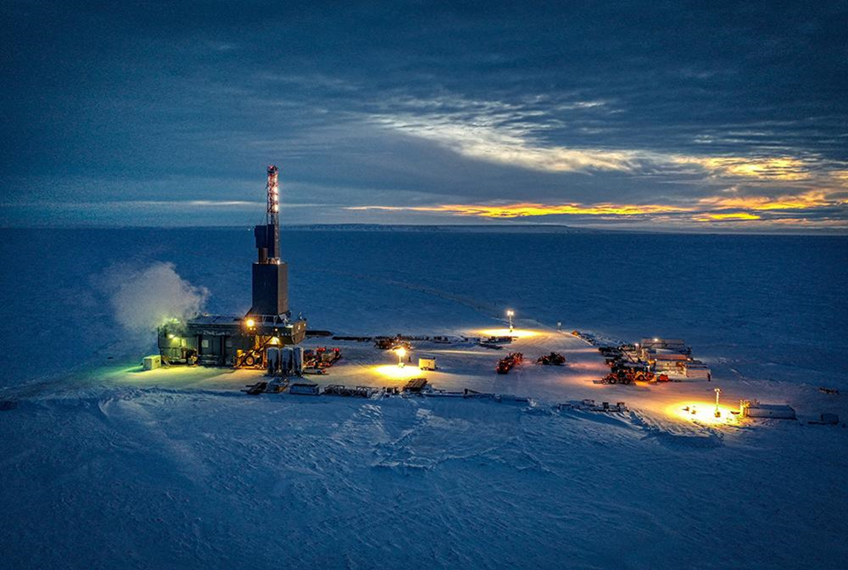
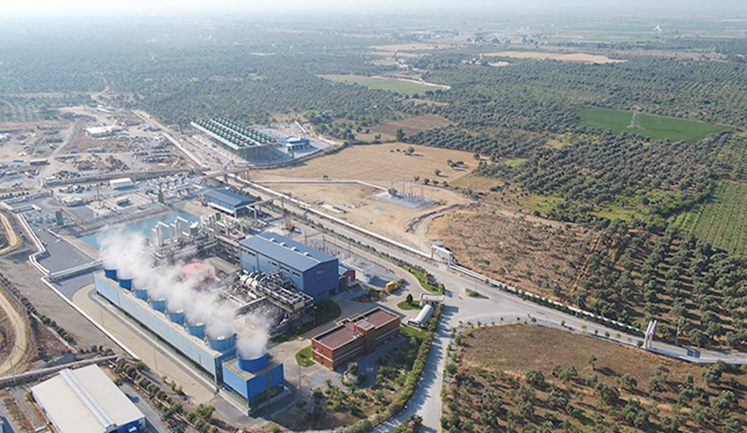
Geothermal Energy makes sense everywhere, from Paris to Munich, from Cornwall to Alberta, from Mexico to Slovakia, from Alexandroupolis to Tura where investors are looking in cheap district heating and base load power generation, as well as seeking important mineral byproducts such as lithium extraction,
Iceland
Turkiye
Iceland
T H A N K Y O U

