Slide 1
Raw Materials University Day
Future Needs and Opportunities
19 June 2014, Athens, Greece
MAGNESITE
GRECIAN MAGNESITE S.A
ELENI ISKOU
SALES SPECIALIST

Slide 2
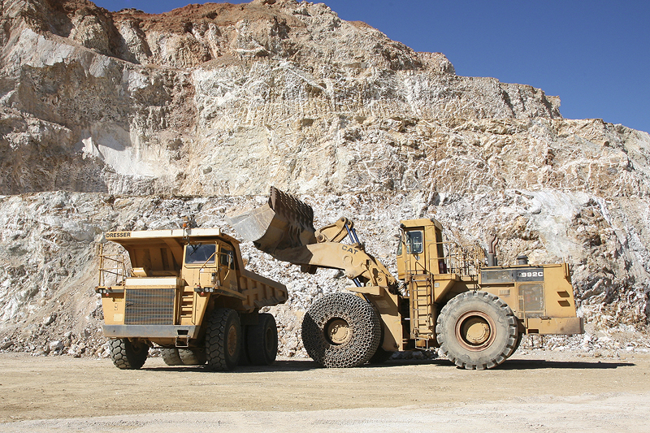
Company’s profile
In 1959 Grecian Magnesite was established by Mr G. Portolos. Privately owned company.
Head quarters in Athens
Mines and production facilities in Yerakini, Chalkidiki, Northern Greece
R&D center in Vassilika, Thessaloniki
The primary business activity is the mining, beneficiation and calcination of magnesium carbonate for the production of caustic calcined magnesia, dead burned magnesia, unshaped basic refractories and magnesium carbonate

Slide 3
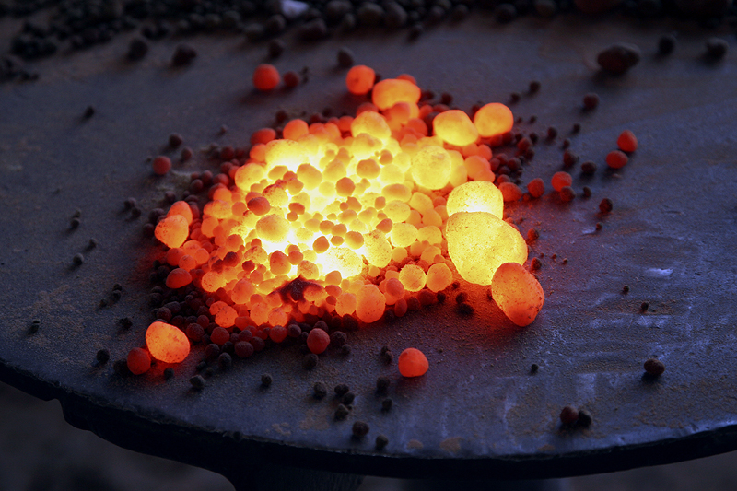
Fully integrated production facilities
Annual production capacity of 200.000mt of calcined products
More than 60 different MgO grades
Export activity with sales to more than 60 countries in all continents
ISO 9001:2008 and GMP+ certificates
367 employees in Greece
The oldest natural CCM producer and exporter in the EU

Slide 4
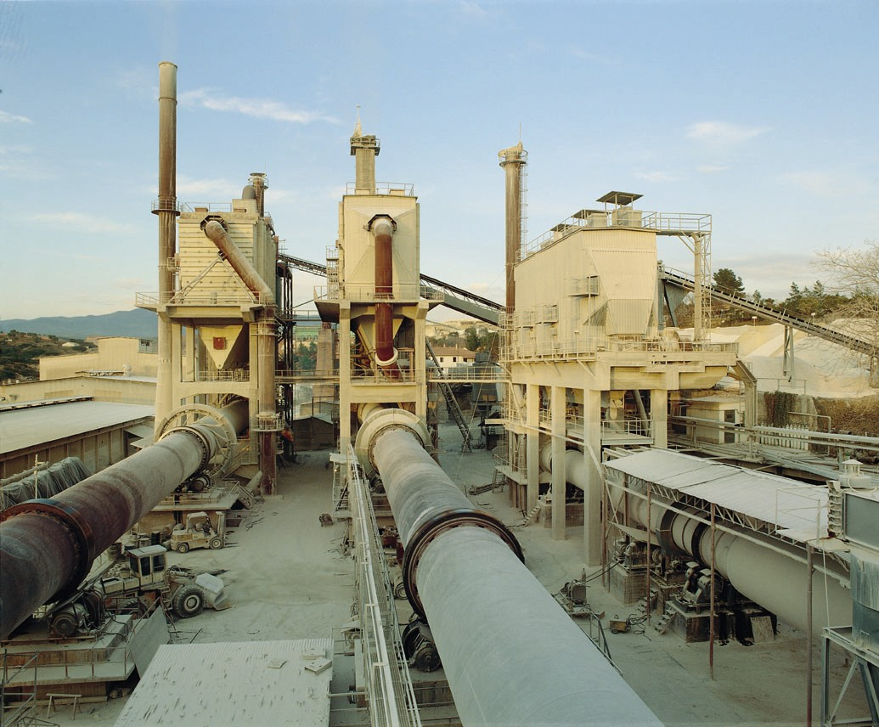
Grecian Magnesite has implemented substantial investments in Yerakini for the expansion and improvement of our mines and production process.
Only in the last decade the cost of investments on new equipment amounted 32 million EUR.
Optimization of productivity: New beneficiation methods for the utilization of the old stock piles (secondary reserves)
State of the art production technologies such as laser optical sorters, high intensity magnets and Greco screens.
Minimization of environmental impact
-Land restoration
-Use of bio fuels
-Water recycling
-Dust emission control

Slide 5
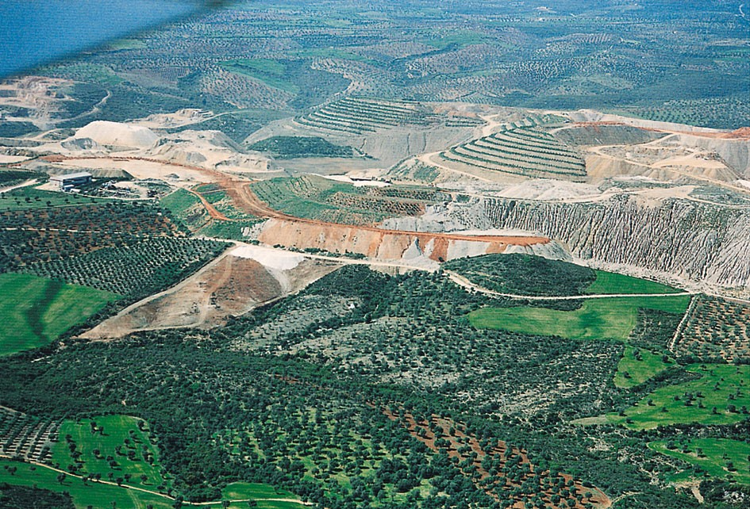

Slide 6
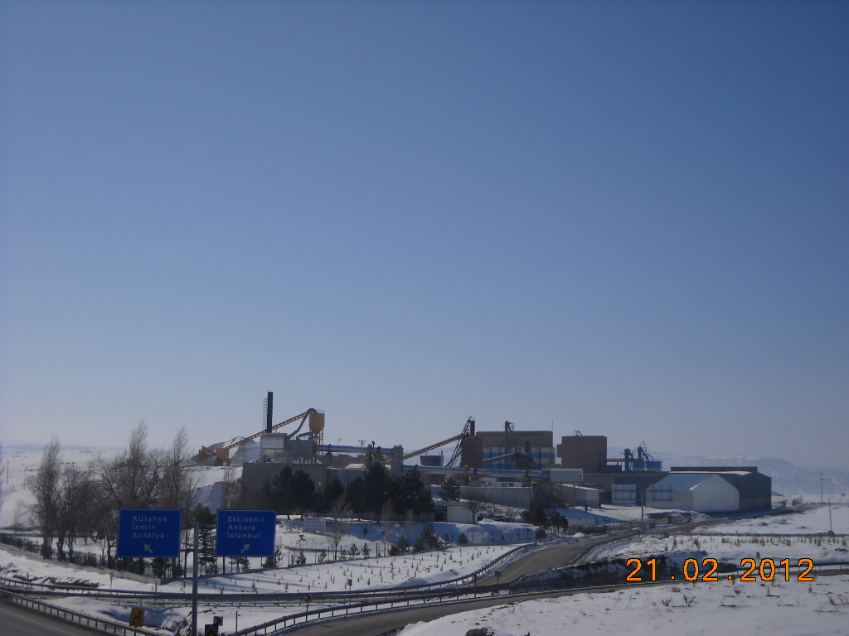
Vision
Our global vision is to expand our presence in high growth markets and participate in magnesite activities in mature markets and to create a world class manufacturing center for the production of innovative magnesia specialties with raw materials from around the world.
Activities outside Greece
Our participations :
Magnesitas Navarras SA in Spain (40% share)
Van Mannekus & Co BV in the Netherlands (50% share)
Akdeniz Mineral Kaynaklari A.S in Turkey (90% share)

Slide 7
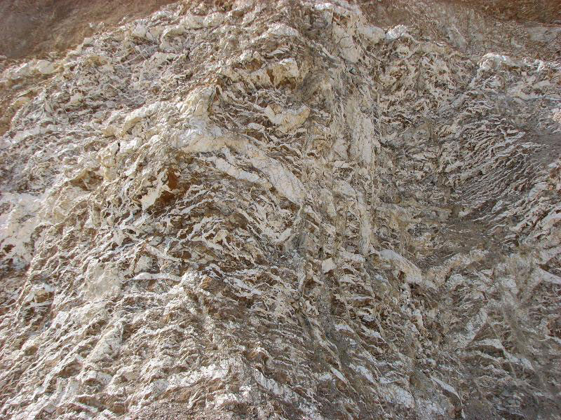
Production Process - Yerakini Mines

Slide 8
Mining Open pit mine Magnesite ore of stockwerk type - Microcrystalline Host rock dunite - serpentine
Pre-beneficiation Separation of magnesite from host rock
Processing Method: Laser sorters
Beneficiation Qualitative separation of raw magnesite grades into different qualities – kiln feed material
Processing Methods: Camera sorters - Magnetic separation - Heavy media separation
Calcination MgCO₃ MgO + CO₂ - 3 rotary and 2 shaft kilns
Calcination at 1.100ºC Caustic Magnesia
Calcination at 1.900ºC Dead Burned Magnesia
Final processing of CCM and DBM
Production of refractory mixes.

Slide 9
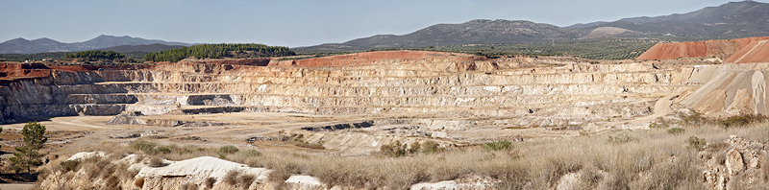

Slide 10
International Environment of MgO production
Mature Market
Global overcapacity in the production of MgO
Major player is China especially for the commodity grades (animal feed and refractories) with 70% of global resources
Main competition from producers outside the European Union and different legislative framework (environmental legislation, energy cost, taxes)
Booming on access to market information communication and logistics that brings down distances
Magnesite is classified as critical raw material in the Critical Raw Materials List – Revision 2014

Slide 11
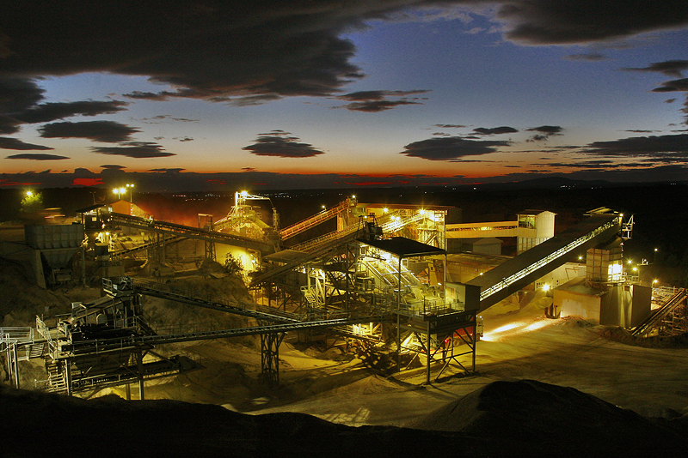

Slide 12
Grecian Magnesite Sales Strategy
The company’s sales strategy is to combine traditional magnesite applications and new niche markets for specialized products
To establish long term and close collaborations with customers
The company exports to 60 countries in all five continents. Exports represent 90% of our sales value
It becomes obvious that, apart from the large number of uses, the company has the advantage of dealing with very many countries whose business conditions don’t always coincide.

Slide 13
Grecian Magnesite Sales Tools
To take advantage of the chemical composition and physical properties of Yerakini deposit and production Know how that differentiate our grades from rival products
Continuous research & development
Custom made products and Application know-how
Technical exchanges with customers
After sales service
Name and reputation
Excellent logistics

Slide 14
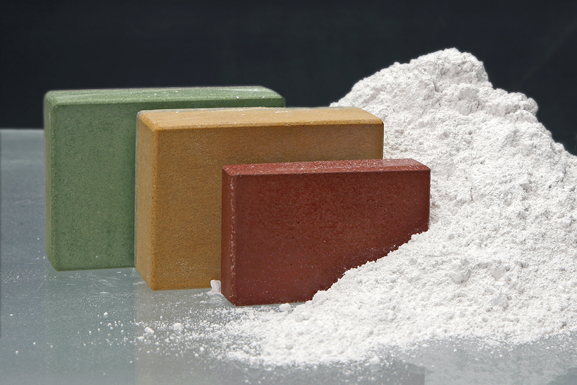
Products & Applications
Caustic calcined magnesite (reactive MgO)
Purity: 80-98% MgO with SiO2 and CaO main impurities
Low Fe and trace element content
Wide range of reactivities with SSA: 10-100m2/g

Slide 15
Markets
Animal Feed and Fertilizers
Industrial Floors and Panels, Abrasives, Ceramics
Magnesium compounds
Rubber and plastics
Heating Elements
Fuel additives
Hydrometallurgy of Ni, Co, U
Spinel production
Fused magnesia Production
Environmental applications: Soil decontamination, Municipal and Industrial Waste water treatment, Flue Gas Treatment

Slide 16
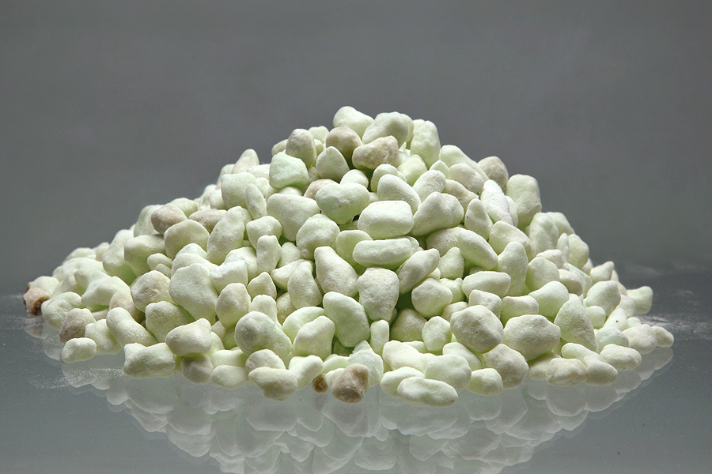
Dead Burned Magnesite
Purity 80-96% MgO
Bulk density: 3,2-3,4g/cm3

Slide 17
Markets:
Basic Refractories
Welding Fluxes
Leather tanning
Heating Elements (Electrical Powders)
Dental Applications
Encapsulation of wastes (phosphate cements)

Slide 18
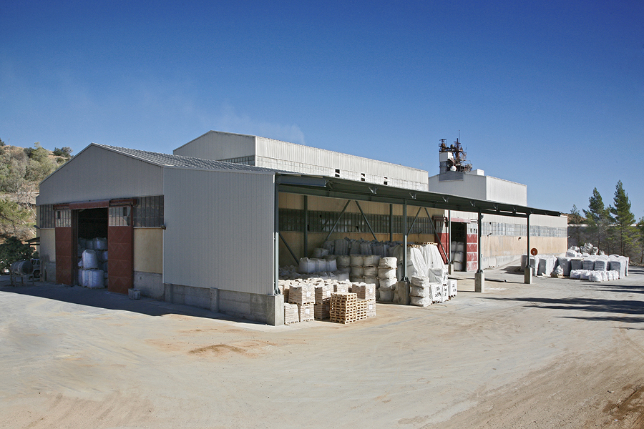
Basic Monolithic Refractories
Unshaped refractories for the steel industry
Gunning Mixes – Dry Mixes- Tundish coating mixes- Mortars
Production of Refractory Masses and Deadburned Magnesite Powders in a separate business unit.
Fully automated and computerized production process
Production capacity of 50.000mt
Separate installation for the production of electrical powders with 10.000mt capacity

Slide 19
Our People
Administration: 60
Technical Personnel: 79
Labor Force: 198
Basic contractors: 30
Total: 367
Grecian Magnesite is one of the most important employers at Polygyros, Chalkidiki region.
Continuous training of our employees
Health and Safety at work is top priority

Slide 20
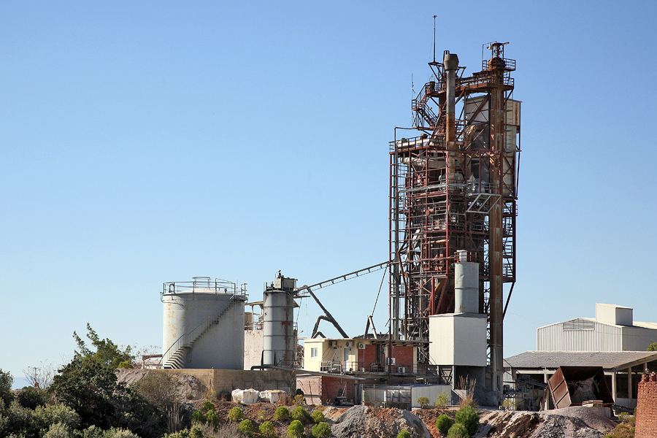

Slide 21
The future - Guidelines
To further optimize the utilization of Yerakini reserves with the adoption of new technologies
To maximize the utilization of raw materials from the old stock piles that will extend the life of the mine. 30% of kiln feed material comes from the old stock piles
To expand the use of eco friendly technologies to minimize the environmental impact
To further invest in Research and Development
To emphasize on eco friendly products and applications of MgO

Slide 22
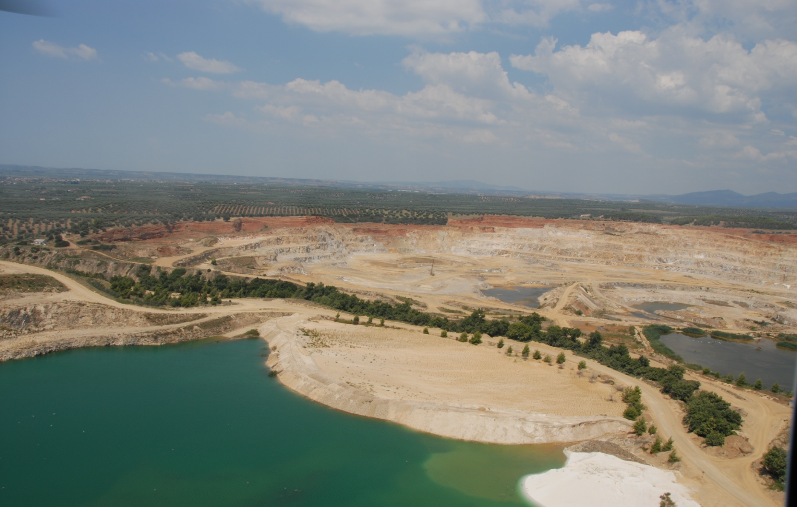

Slide 23
Within the framework of the Strategic Implement Plan of EIP on Raw Materials, Grecian Magnesite participated in the submission of the proposal, which is approved and received the label as an RMC Project
Full title:
“Innovation Network to increase the Competitiveness of the European Magnesium/Magnesite sector through Environmental and Social Sustainability”
Acronym: INCOMES

Slide 24
ACTION 1: CREATION OF THE EUROPEAN NETWORK
ACTION 2: INCREASED RESERVES OF MAGNESITE
ACTION 3: SUSTAINABLE AND EFFICIENT EXPLOITATION OF MAGNESITE MINES
ACTION 4: ECO-DESIGN OF PRODUCTS
ACTION 5: WASTE RECYCLING

Slide 25
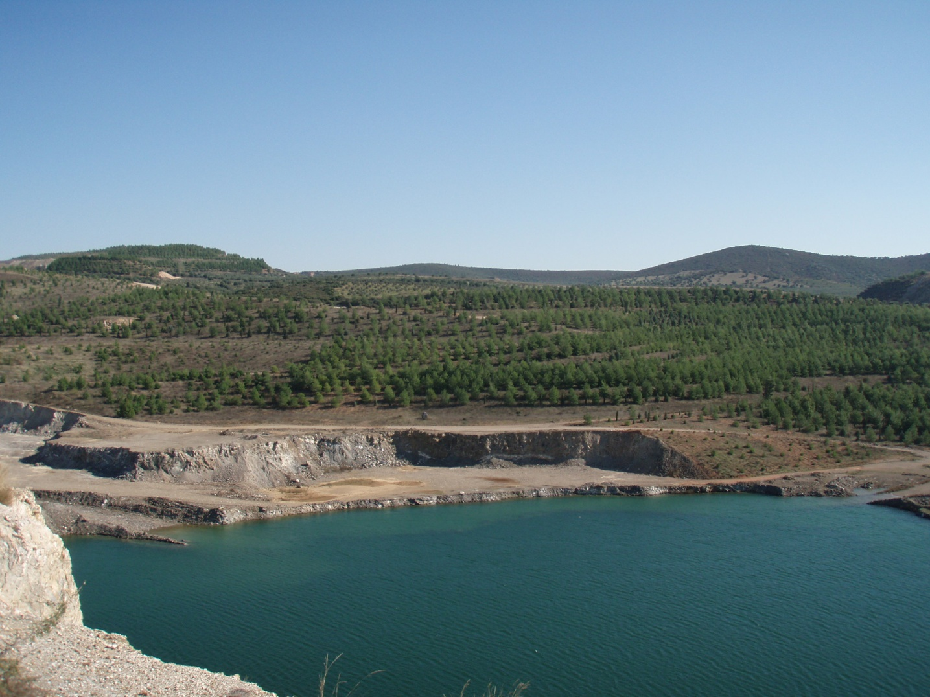
www.grecianmagnesite.com

