Slide 1


RAW MATERIALS UNIVERSITY DAY
Future, needs and opportunities
Athens, June 19th
      Bentonite – Perlite – Wollastonite
      Dr. A. Karalis, R&D Specialties Manager,
      Global Market Organization, S&B Industrials Minerals

Slide 2

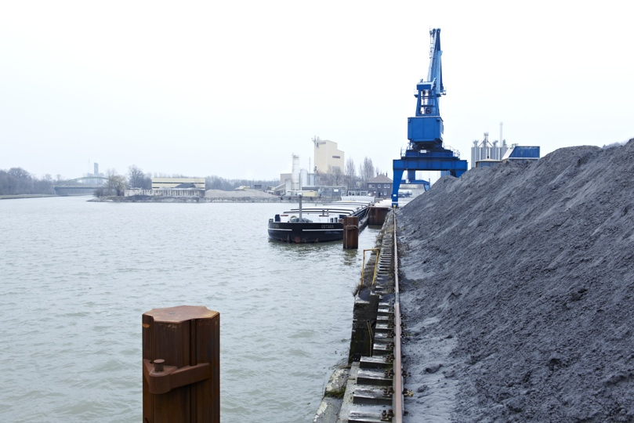

No 1 Bentonite producer in Europe and No 2 worldwide
No 1 raw graded Perlite producer worldwide
No1 Wollastonite producer worldwide (in value)
No 1 producer of Casting Fluxes worldwide
No 1 Bauxite producer in the EU
We provide innovative
Industrial Solutions globally by
developing and transforming
natural resources into
value creating products
2

Slide 3

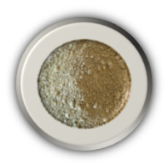
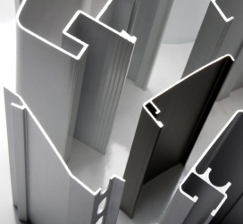
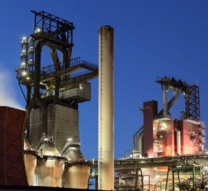
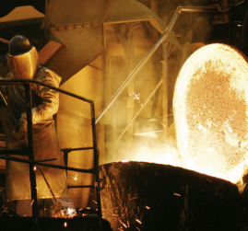
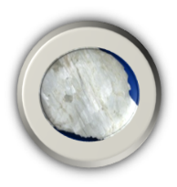
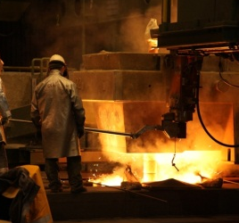
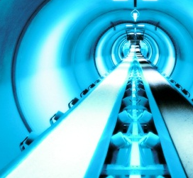
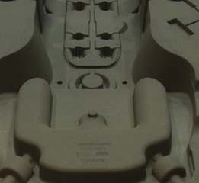
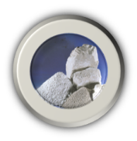

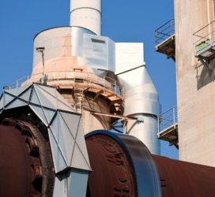
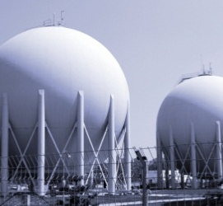
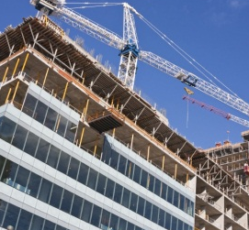
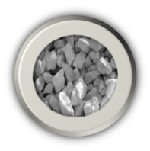
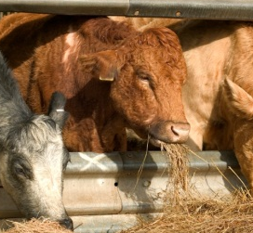
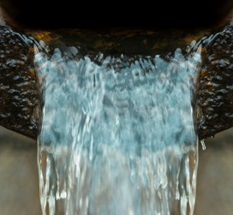
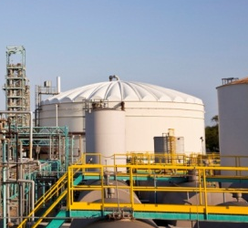
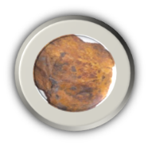
Transforming natural resources to provide industrial solutions globally to Four key market Segments
Bentonite
Metallurgy
Continuous steel casting
Iron ore pelletizing
Alumina
Refractories
Iron smelting
Wollastonite
Foundry
Mold sand additives
Core sand additives
Inorganic binders
Perlite
Construction
Building materials
Civil engineering
Cements
Drilling
Cryogenics
Other
Continuous
Casting
Fluxes
Specialty
Minerals
Specialties
Plastics
Glass & ceramics
Horticulture
Absorbents
Paints & Coatings
Other
Bauxite
Notes:
Salt & pepper solutions, important for customer at small cost
Industrial B2B supplier to key market segments that “touch” our living to a great extent
Leading market positions with our products in varied end-market applications

Slide 4

Sales per Segment and per Region
Sales 2012
in € million
-2.2%
-1.6%
+21%
+8.3%
+3.2%
+9%
+8%
-1%
+1%

Slide 5



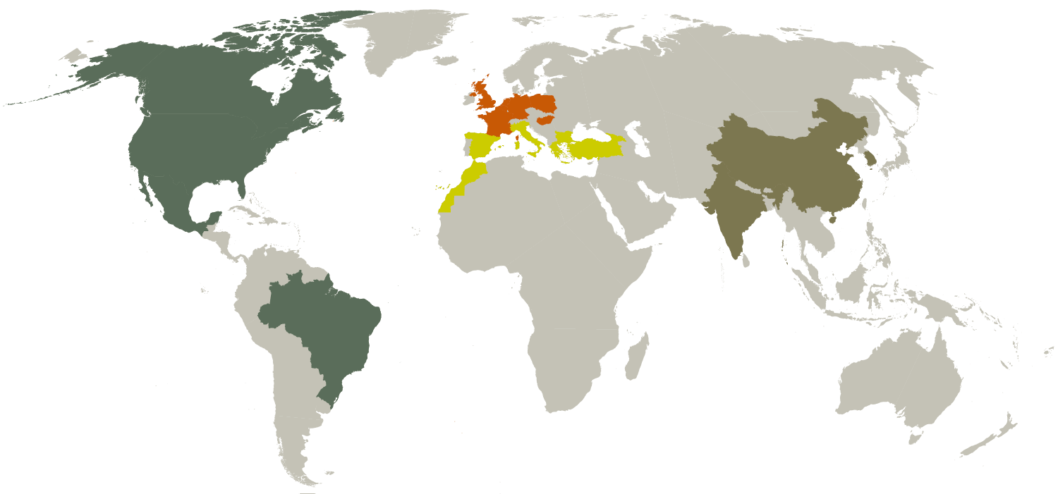
Global presence with dispersed operations
30
50
26
mines
plants
Distribution centers
4 countries 25 site locations 411 employees 108 €m sales
7 countries 26 site locations 530 employees 211 €m sales
7 countries 42 site locations 886 employees 124 €m sales
3 countries 13 site locations 274 employees 27 €m sales

Slide 6
To discuss today: Development of the New Strategy for IM
Questions:
How a Greek Company becomes a Global player?
How a Mining Company is transformed into an “Industrial Solutions provider”?
Answers:
Switch from Mine to Market to “Market-to-Mine” approach
Invest in People
Find and secure Funding

Slide 7
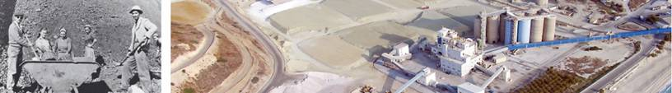
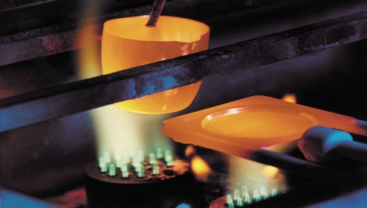
Downstream diversification through targeted key-investments
€230+ million in key acquisitions
for geographical, downstream and applications diversification
’98-’99
2000
2001
2003
2004
2007
2012
Otavi
IKO
S&B
Hungary
S&B
Bulgaria
Stollberg
Group
Hill & Griffith
NYCO
Minerals
Mykobar
CEBO JV
Perlite
Mineral Trading
Bentonite
Bentonite
Bentonite
Bentonite
Perlite
Fluxes
Bentonite
Wollastonite
Tripoli
Pelletising
Construction
Horticulture
Foundry
Civil engineering
Cat litter
Specialties
Civil
engineering
Civil engineering
Cat litter
Construction
Horticulture
Continuous
steel casting
Foundry
Drilling
Plastics
Paints
Coatings
..from digger & shipper ….. ...to an industrial solutions provider

Slide 8
The 3 Dimensions of the New Strategy
New geographies
New solutions
Diversify applications

Slide 9

The New Strategy of S&B for Industrial Minerals
An example:
From Bentonite and Perlite in Greece to Wollastonite in USA

Slide 10
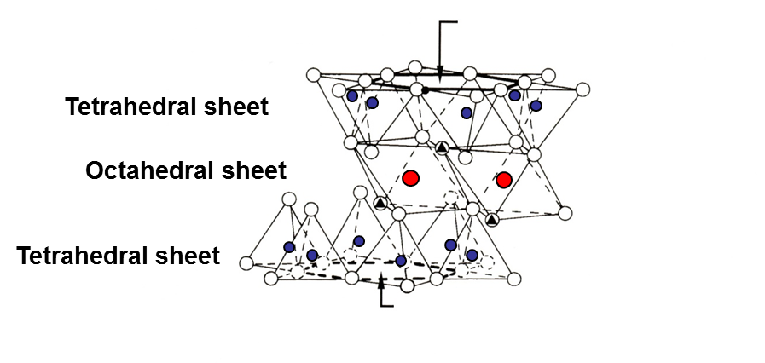

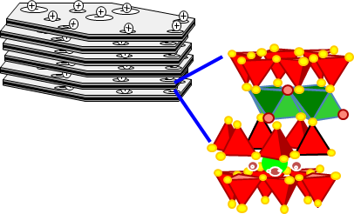
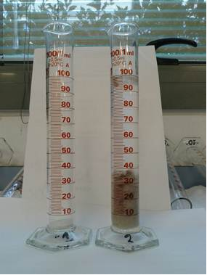
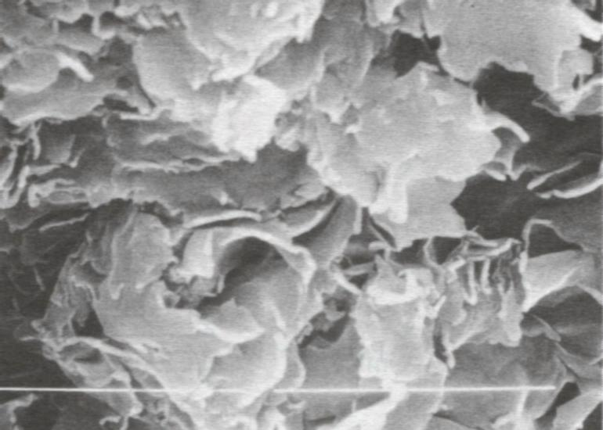
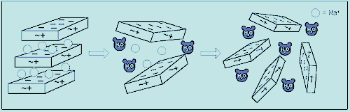
What is Bentonite?
Bentonite is a Clay which contains a mineral from the Smectite Group
Smectites are Trioctaedral (Talc, Vermiculite) or Dioctaedral (Montmorillonite, Nontronite) Minerals, characterized by their Exhangeable Cations (Ca⁺², Na⁺¹)
Greek Bentonites contain mainly Ca-Montmorillonite, non swellable in H₂O
After Activation ‘Montm ’ becomes highly swellable (12-18 to 1) and is used in several Applications (Metallurgy, Foundries, Construction, Drilling, Water Treatment, Catalysis, ..)
Key-properties: Swelling, H₂O absorption (7-10 to 1), Binding, Colloidality, Thixotropy
Smectite in H₂O environment
(Holtz and Kovacs, 1981)

Slide 11


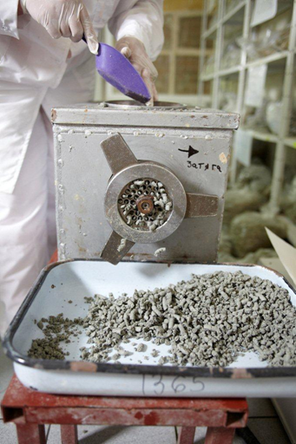
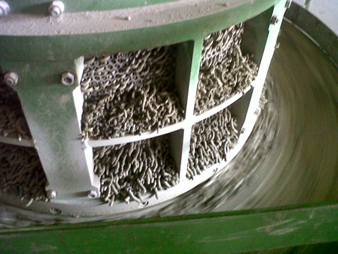
How Bentonite is processed
Ca-Montmorillonite is Activated with Soda Ash:
+4Na₂CO₃
+4CaCO₃ 
Activation through Extrusion in the Lab
Activation through Extrusion in the Plant

Slide 12
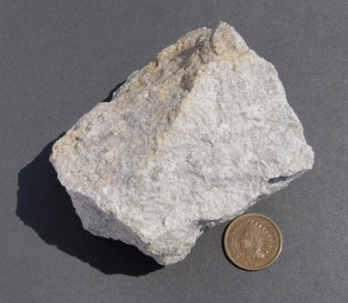
What is Perlite?
Perlite is a generic term for naturally occurring siliceous rock: Volcanic glass (70-76% amorphous silica and alumina)
Perlite expands 4-20 times its original volume, when rapidly heated to its softening temperature range (>870 °C), due to the presence of 2-5% “combined” H₂O and Alkalis (6-10%)
  “Combined” H2O: mainly in the form of “Silanol groups” [Si-OH bonds]
Key-properties: after expansion perlite particles become extremely lightweight porous bubbles with cellular structure
Applications: Insulation (Buildings & Cryogenics), Hydroponics, Building, Filtration (Beverages, antibiotics)
Silanol Groups

Slide 13
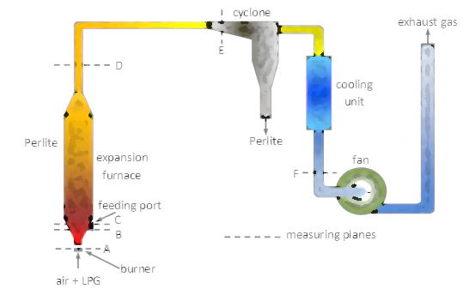
How Perlite is processed
Micronization

Slide 14
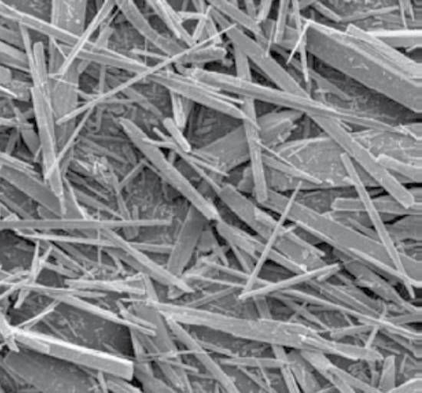
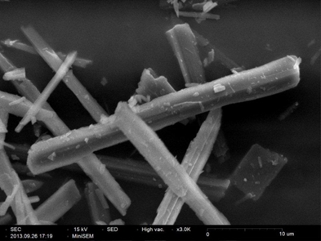
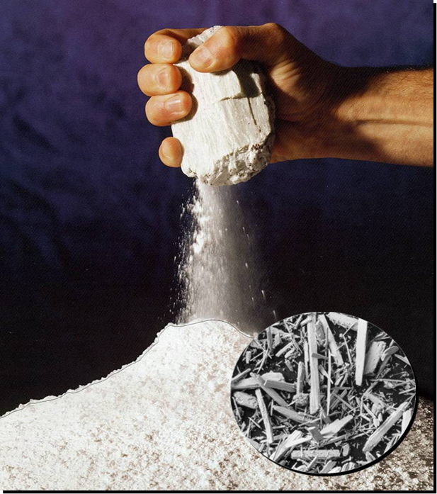

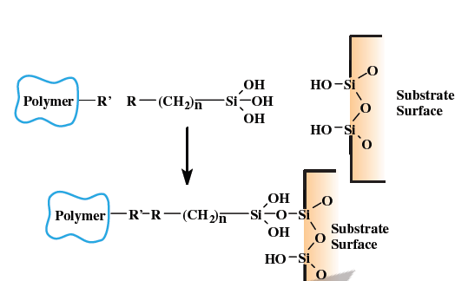
What is Wollastonite?
Wollastonite is a naturally occurring non-metallic white mineral (Calcium Silicate -CaSiO₃)
In the ore body it co-exists with Quartz, Pyroxene, Garnets, and Calcite
Wollastonite has originally Acicular structure and if it is properly treated it yields fibers of high Aspect Ratio (8-12 : 1) providing excellent reinforcement properties to plastics (PO, PA)
Its secondary treatment with polysiloxanes (chemical coating at elevated T) is crucial
Applications: Functional Filler in Plastics and Coatings, Starting material for Ceramics and Metallurgical Fluxes
Key-properties: Acicularity, Purity, whiteness, pH = 10, high melting point

Slide 15
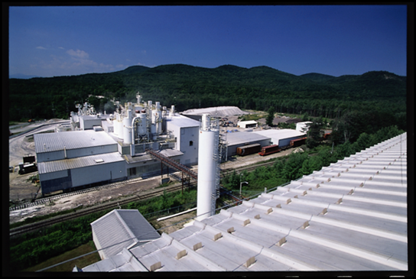
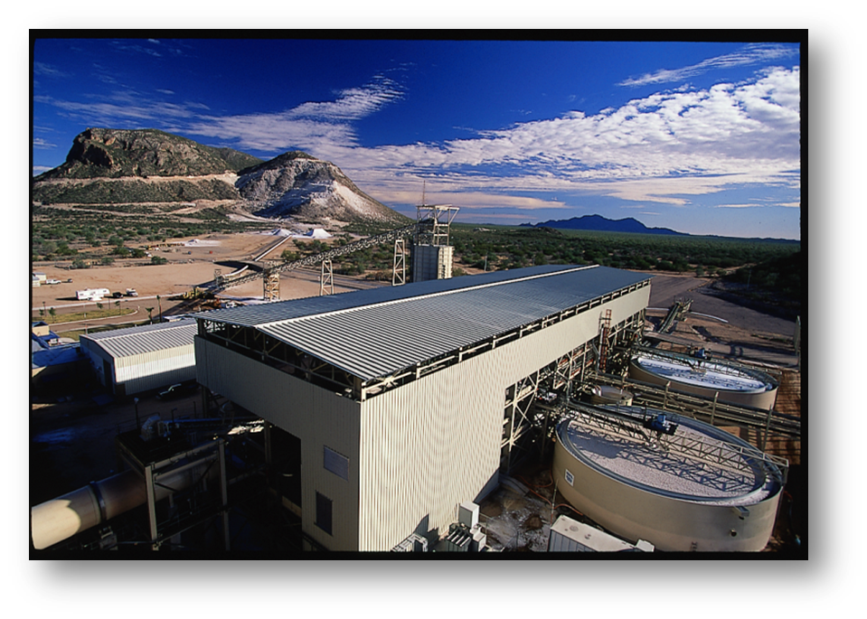
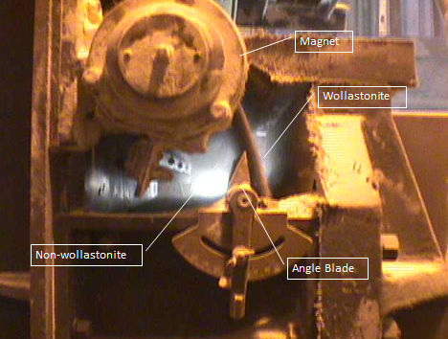
How Wollastonite is processed
Primary Crushing is followed by Secondary crushing and Milling in order the Wollastonite fibers to be deliberated from other minerals
Beneficiation is required to remove impurities (up to 45%) and obtain pure wollastonite
  It may include Magnetic Separation or Floatation or both
Surface coating takes place in simple stirring reactors at T<100 °C

Slide 16
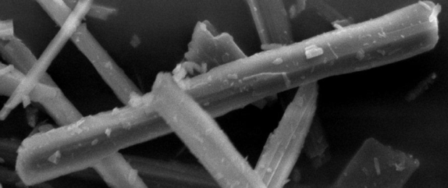

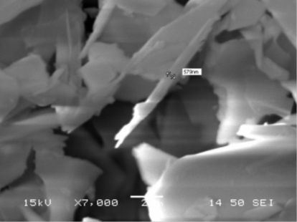

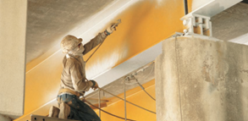
How the New Strategy “works”….
Need for expanding S&B’s Product Portfolio (2011)
Acquisition of a Market Leader (2012):
NYCO as Vehicle for Perlite in P&C
R&D: Micronized Perlite for Plastics & Coatings (2008-9)
Delaminated Bentonite for Coatings (2007-8)
Entering the world of Plastics & Coatings (2009-2011)
NYCO, US: Wollastonite for P&C
Geological Exploration
R&D
Other Minerals for P&C
Wollastonite Fiber
Perlite Flake

Slide 17

Thank you for your attention!

